Slide 1
Communications in Distributed Systems
Dr. Saurabh Jha
Assistant Professor
School of Computer Engineering
KIIT Deemed to be University
Bhubaneswar

Slide 2
UNIT-2: Communications in Distributed Systems
Basics of Communication Networks
Layered Protocols
ATM Models
Client-Server Models
Blocking and Non-Blocking Primitives
Buffered and Unbuffered Primitives
Reliable and Unreliable Primitives
Message Passing
Remote Procedure Calls

Slide 3
Blocking versus Nonblocking Primitives
Message Passing: A message-passing system gives a collection of message-based IPC (Inter-Process Communication) protocols.
The send() and receive() communication primitives are used by processes for interacting with each other.
For example, Process A wants to communicate with Process B then Process A will send a message with send() primitive and Process B will receive the message with receive() primitive.
Synchronization Semantics: The following are the two ways of message passing between processes:
Blocking (Synchronous)
Non-blocking (Asynchronous)

Slide 4
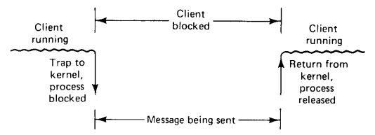
Cont..
In case of blocking primitive (also called as synchronous primitives), when a process calls send it specifies a destination and a buffer to send to that destination.
While the message is being sent, the sending process is blocked (i.e., suspended).
The instruction following the call to send is not executed until the message has been completly sent, as shown in figure below.
Similarly, a call to receive does not return control until the message has actually been received and put in the message buffer.
Figure 1: A blocking send primitive

Slide 5
Cont..
An alternative to blocking primitives are nonblocking primitives (also called as asynchronous primitives).
If send is nonblocking, it returns control to the caller immediately, before the message is sent.
The advantage of this scheme is that the sending process can continue computing in parallel with the message transmission, instead of having the CPU go idle.
The disadvantage of this scheme is that the sender cannot modify the message buffer until the message has been sent.
The sending process has no idea of when the transmission is done, so it never knows when it is safe to reuse the buffer.
There are two possible solutions to this problem:
The first solution is to have the kernel copy the message to an internal kernel buffer and then allow the process to continue, as shown in Figure 2 in the next slide.
The disadvantage of this method is that every outgoing message has to copied from user space to kernel space.

Slide 6
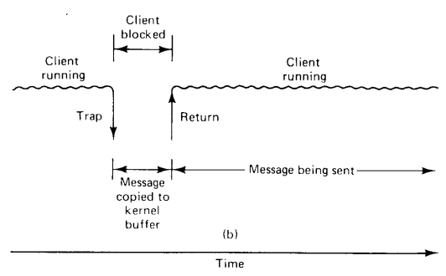
Cont..
Figure 2: A nonblocking send primitive

Slide 7
Cont..
The second solution is to interrupt the sender when the message has been sent to inform it that the buffer is once again available.
No copy is required here, which saves time, but programs based on user-level interrupts are difficult to write and debug.
Blocking and nonblocking send primitives:
Blocking send() primitive: The blocking send() primitive refers to the blocking of sending process.
The process remains blocking until it receives an acknowledgment from the receiver side that the message has been received after the execution of this primitive.
Non-blocking send() primitive: The non-blocking send() primitive refers to the non-blocking state of the sending process that implies after the execution of send() statement, the process is permitted to continue further with its execution immediately when the message has been transferred to a buffer.

Slide 8
Cont..
Just as send can be blocking and nonblocking, so can receive.
Blocking receive() primitive: when the receive statement is executed, the receiving process is halted until a message is received.
Nonblocking receive() primitive: The non-blocking receive() primitive implies that the receiving process is not blocked after executing the receive() statement, control is returned immediately after informing the kernel of the message buffer’s location.
The issue in a nonblocking receive() primitive is when a message arrives in the message buffer, how does the receiving process know?
One of the following two procedures can be used for this purpose:
Polling: In the polling method, the receiver can check the status of the buffer when a test primitive is passed in this method.
The receiver regularly polls the kernel to check whether the message is already in the buffer.

Slide 9
Cont..
Interrupt: A software interrupt is used in the software interrupt method to inform the receiving process regarding the status of the message i.e. when the message has been stored into the buffer and is ready for usage by the receiver.
So, here in this method, receiving process keeps on running without having to submit failed test requests.

Slide 10
Cont..
Issues involved in blocking send() and receive() primitive:
Blocking send() primitive: The issue that can be raised here is that the sending process may become permanently halted if receiving process has crashed or the sent messages are lost because of communication failure.
So, blocking send() primitives must set a fixed time value which when elapsed, send operation is halted with an error status to avoid this problem.
Users might be given the option to specify the timeout value as a parameter of the send primitive, or it could be set as a default.
Blocking receive() primitive: To avoid the receiving process from becoming halted indefinitely, a blocking receive() primitive might be connected with a fixed time value.
This can happen if the prospective sending procedure fails or if the expected message is lost on the network owing to a communication breakdown.

Slide 11
Buffered versus Unbuffered Primitives
Unbuffered Primitives:
Unbuffered primitives involve direct communication without any intermediate storage.
In these primitives, the sender and receiver need to be synchronized for the communication to take place.
A call to the primitive receive(addr, &m) tells the kernel of the machine on which it is running that the calling process is listening to the address addr and is prepared to receive one message sent to that address.
A single message buffer, pointed to by m, is provided to hold the incoming message.
When the message comes in, the receiving kernel copies it to the buffer and unblocks the receiving process, as shown by Figure 3 in the next slide.

Slide 12
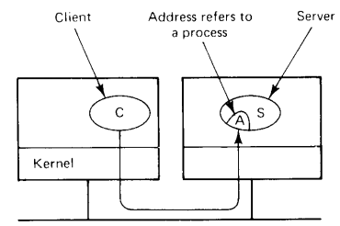
Cont..
Figure 3: Unbuffered message passing

Slide 13
Cont..
The call to receieve is the mechanism that tells the server’s kernel which address the server is using and where to put the incoming message.
What are the problems that occurs when the client calls send primitive before the server calls receive primitive in unbuffered message passing mechanism?
The problems are as follows:
How does the server’s kernel knows which of its process is using the address in the newly arrived message?
How does the server’s kernel knows where to copy the message?
To avoid such problems, it's crucial to ensure that the receive primitive is called in a timely manner. Some strategies to handle this include:
Pre-emptive Design: Design the system so that the receive is always invoked before or concurrently with send to avoid blocking.
Timeouts and Error Handling: Implement timeouts or error handling mechanisms to manage situations where a send operation might block indefinitely.
Buffered Communication: Use buffered message passing where messages are stored in a buffer temporarily, allowing the sender and receiver to operate asynchronously and reducing the risk of blocking.

Slide 14
Cont..
Buffered primitives:
In order to deal with the buffer management issues, a new data structure called a “mailbox” is defined.
A process that is interested in receiving messages tells the kernel to create a mailbox for it, and specifies an address to look for the network packets.
Henceforth, all incoming messages with that address are put in the mailbox.
The call to receive removes on message from the mailbox, or blocks if none is present.
In this way, the kernel knows what to do with incoming messages and has a place to put them.
This technique is referred as buffered primitive, as shown by Figure 4, in the next slide.

Slide 15
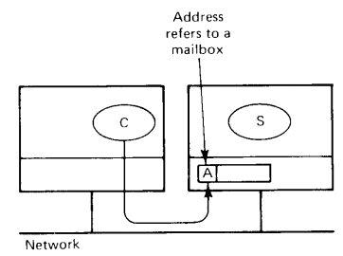
Cont..
Figure 4: Buffered message passing

